Slide 1
Face Mask Detection
using
Transfer Learning and Computer Vision
Submitted in the partial fulfillment for the award of the degree of
BACHELOR OF ENGINEERING
IN
SPECIALIZATION IN AIML
Submitted by:
Aashish Kalra
20BCS6852
Harshil Jain
20BCS6877
Shubharthak Sangharasha
20BCS6872
Under the Supervision of:
Dr. Amit Garg
Department of AIT-CSE
DISCOVER . LEARN . EMPOWER

Slide 2
Outline
Introduction to Project
Problem Formulation
Objectives of the work
Methodology used
Results and Outputs
Conclusion
Future Scope
References

Slide 3

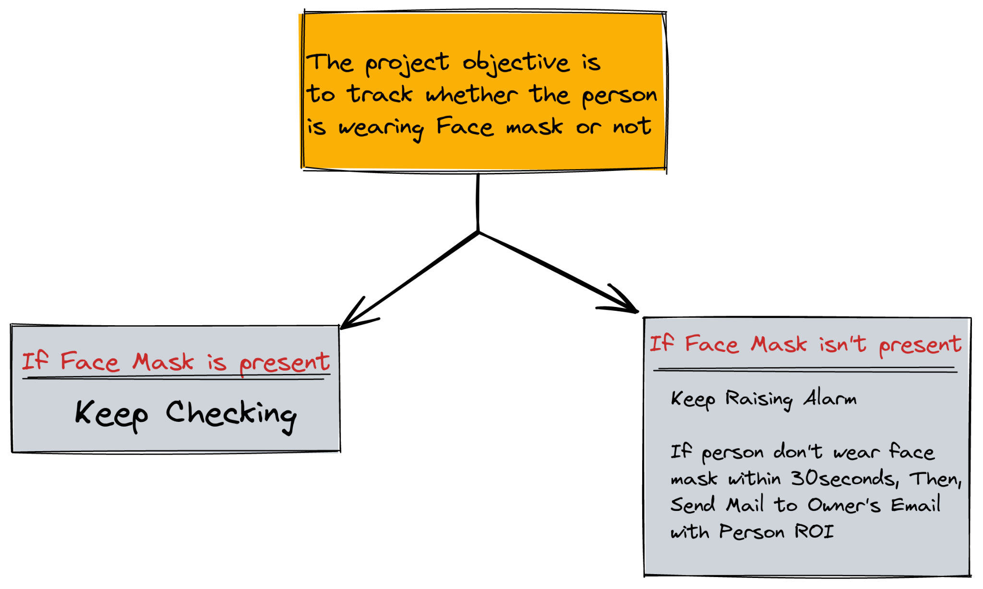


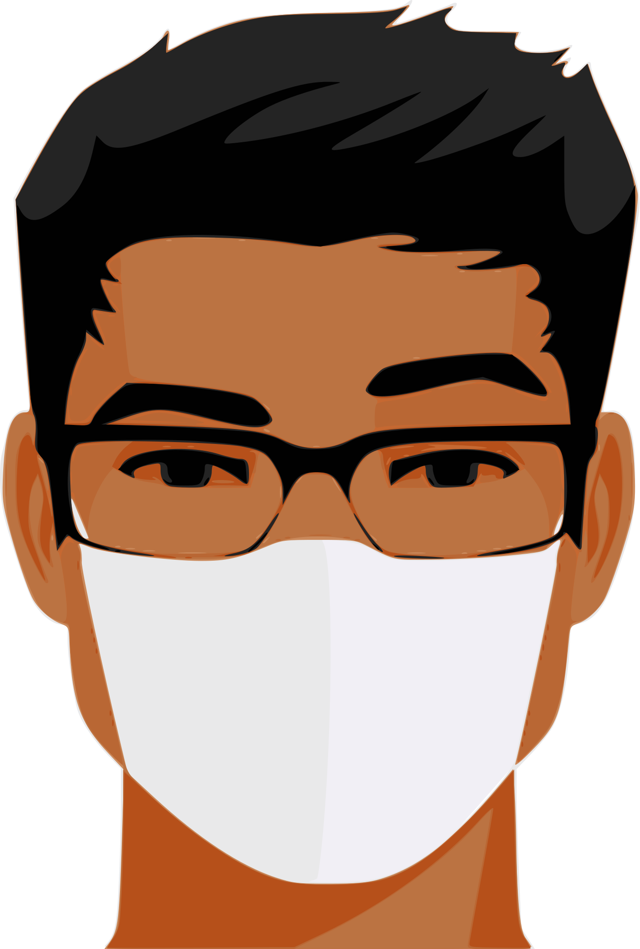
Introduction to Project

Slide 4
The System which we are proposing we are trying to eliminate cons of the existing system by making it more beneficial and reliable.
In the current system the accuracy of the system is very low and inefficient and even it doesn’t guide or warn our user to wear the mask, in our project our UI will guide the user to wear the mask and even our program will send the mail to the authorised committee which will tell that this person is not wearing any mask by sending the picture as well.
The System which we are proposing needs very low maintenance and it is automated, we just need to run the program and then it will handle everything else on its own and by this, our work will be done with least efforts and effectively.

Slide 5
Problem Formulation
The novel coronavirus covid-19 had brought a new normal life.Declared by the WHO that a potential speech by maintaining distance and wearing a mask is necessary.
The biggest support that the government needs after relaxation is social distancing and wearing of masks by the people. But many people are getting out without a face mask this may increase the spread of covid-19.So, it is important to make people wear masks in public places. In densely populated regions it is difficult to find the persons not wearing the face mask and warn them.
Hence, we are using image processing techniques for identification of persons wearing and not wearing face masks. The real time images from the camera are compared with the trained dataset and detection of wearing or not wearing a mask is done. The trained dataset is made by using machine learning technique which is the deciding factor of the result. The algorithm created by means of using a trained dataset will find the persons with and without wearing face masks.

Slide 6
We also added a feature that we can add a video or an image and our program can tell that which person is wearing mask and which person is not wearing mask with an accuracy percentage.
We are also trying to add some other warning devices which will warn the person that he/she is not wearing mask like a beeping device or a LED which will turn Red when a person is not wearing any mask.
If someone tries to get inside without wearing any mask then the machine will take the picture of that person and send it to the authorised committee in real time and will start beeping and our UI will tell him/her that they need to wear the mask to control the spreading of Coronavirus.

Slide 7
Objectives of the Work
In this system a face is detected from an image that has several attributes in it. According to research, face detection requires expression recognition, face tracking, and pose estimation. Given a solitary image, the challenge is to identify the face from the picture. Face detection is a difficult errand because the faces change in size, shape, color, etc and they are not immutable.
Here the main challenge of the task is to detect the face from the image correctly and then identify if it has a mask on it or not. In order to perform surveillance tasks, the proposed method should also detect a face along with a mask in motion
Our project is only software based but for future purposes, our project will use a camera to identify and recognise faces and there face mask, and we are also using a UI guidance system, which will necessitate the use of a speaker. We'd also need a device to maintain all these things and where our software will be loaded; an ideal choice would be a Raspberry Pi or an Arduino Board, but as we're simply submitting software, we won't be utilising one. Also, our programme is OS independent as long as all dependencies are loaded. We developed it on our personal computers. We've also tested on a variety of operating systems, including Windows, Ubuntu, etc.

Slide 8
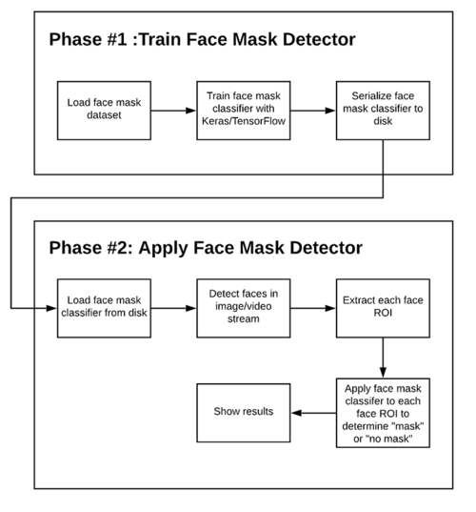
Methodology used

Slide 9
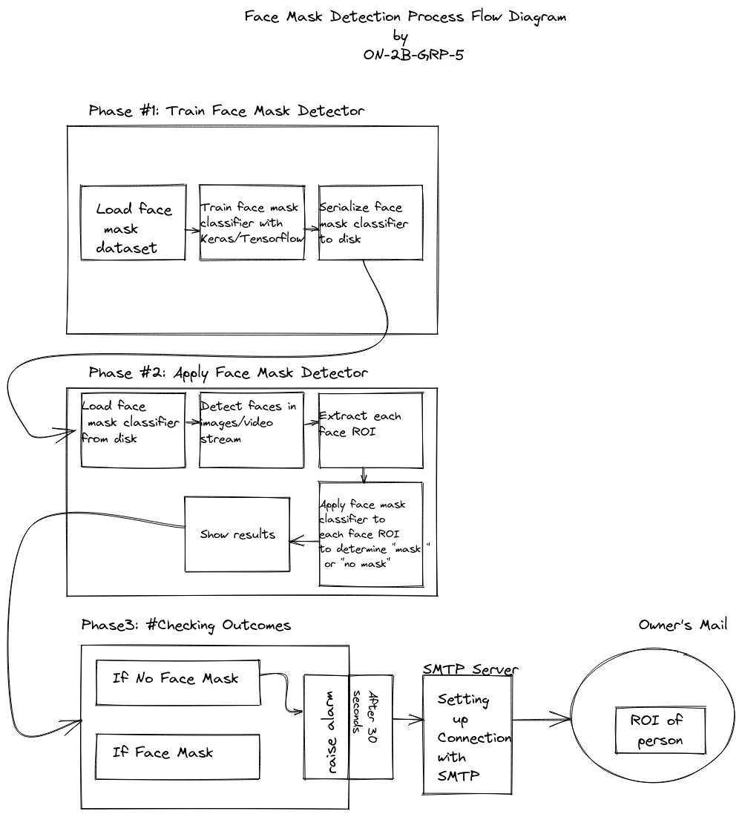

Slide 10
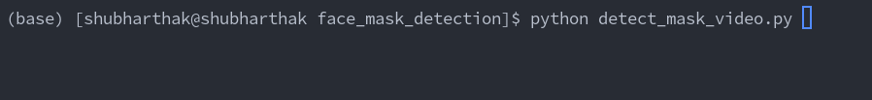
Results and Outputs
Checking Output using Video Stream
1. Turn on the Program using python detect_mask_video.py

Slide 11
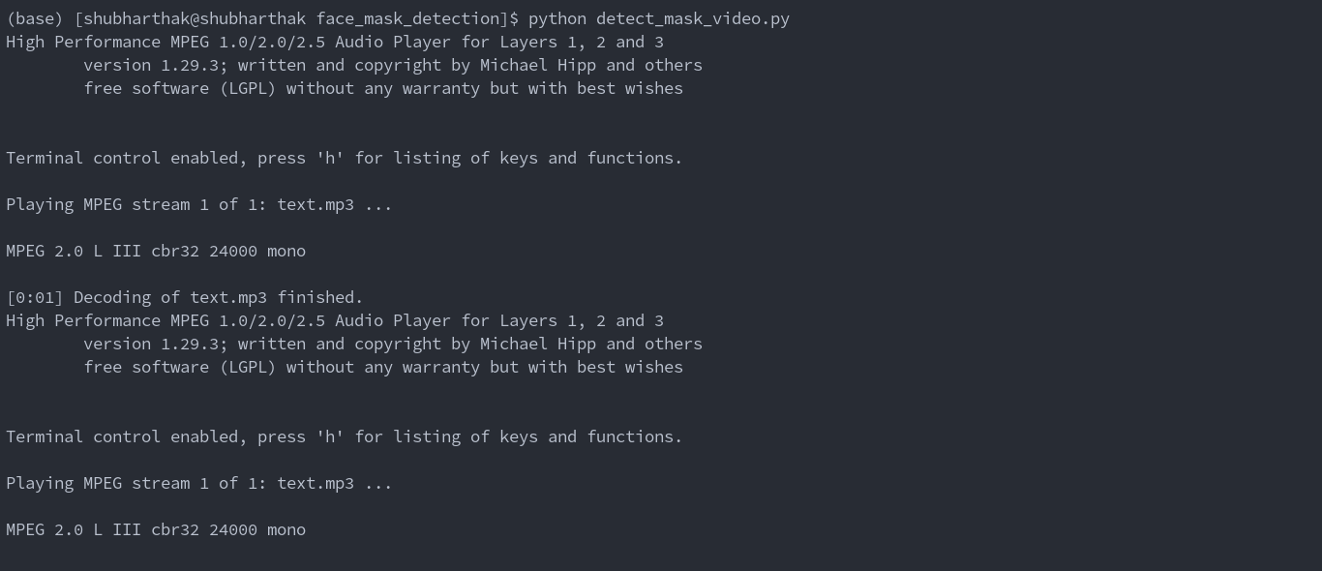
2.Starting the Video Stream and Let gTTS speak and tell the user to wear face mask.

Slide 12
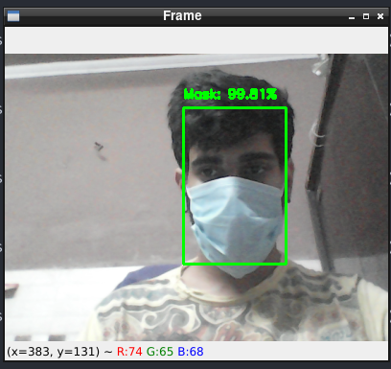
3.Checking whether the Mask Enforcement is On, if yes surround it with Green Box

Slide 13
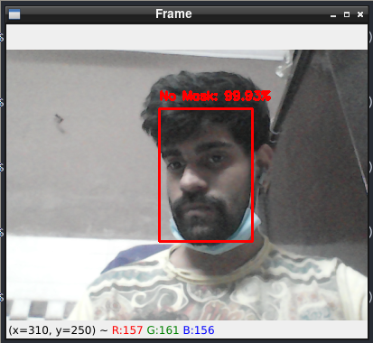
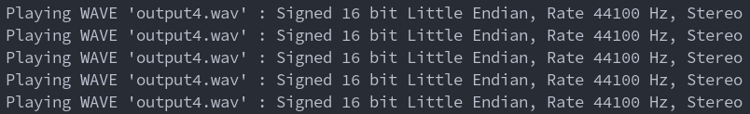

4.If Mask Enforcement is not present raise alarm and surround the user with red box
RAISE ALARM

Slide 14
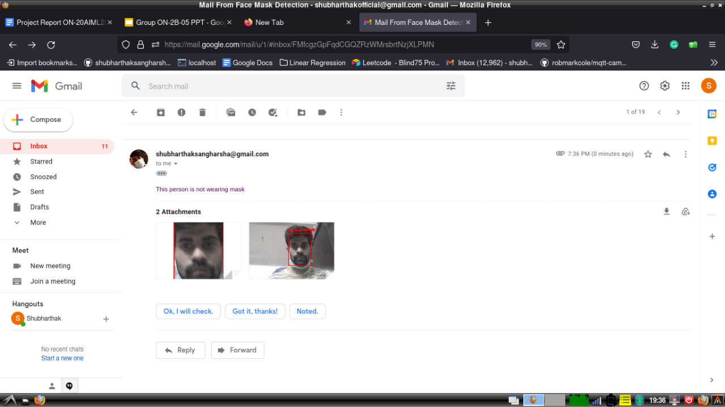
5.Since the person is not wearing mask then his photo without wearing mask will be send to the authorities through email or other designated modes.

Slide 15
Conclusion
Using basic ML tools and simplified techniques the method has achieved reasonably high accuracy. It can be used for a variety of applications.
Wearing a mask may be obligatory in the near future, considering the Covid-19 crisis. Many public service providers will ask the customers to wear masks correctly to avail of their services.
The deployed model will contribute immensely to the public health care system. In future it can be extended to detect if a person is wearing the mask properly or not. The model can be further improved to detect if the mask is virus prone or not,i.e., the type of the mask is surgical, N95 or not.

Slide 16
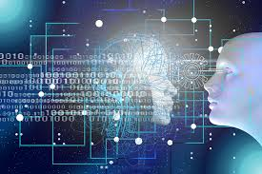
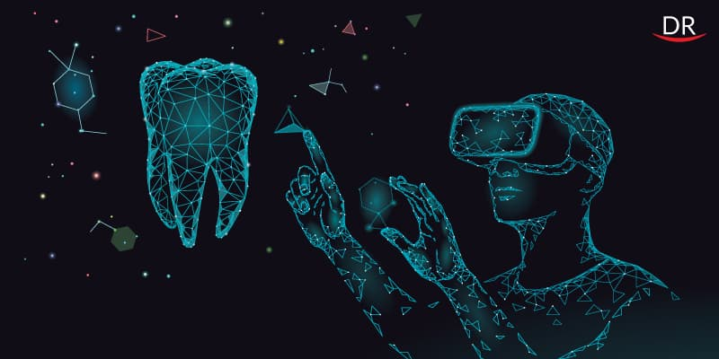
Future Scope
The project can be deployed in raspberry pi to make it more efficient and practical for the real-life purposes.
Deployment of the project on a Website using streamlite
3-Class Feature can be implemented i.e Proper_Facemask, Improper_Facemask and Without_Facemask.

Slide 17
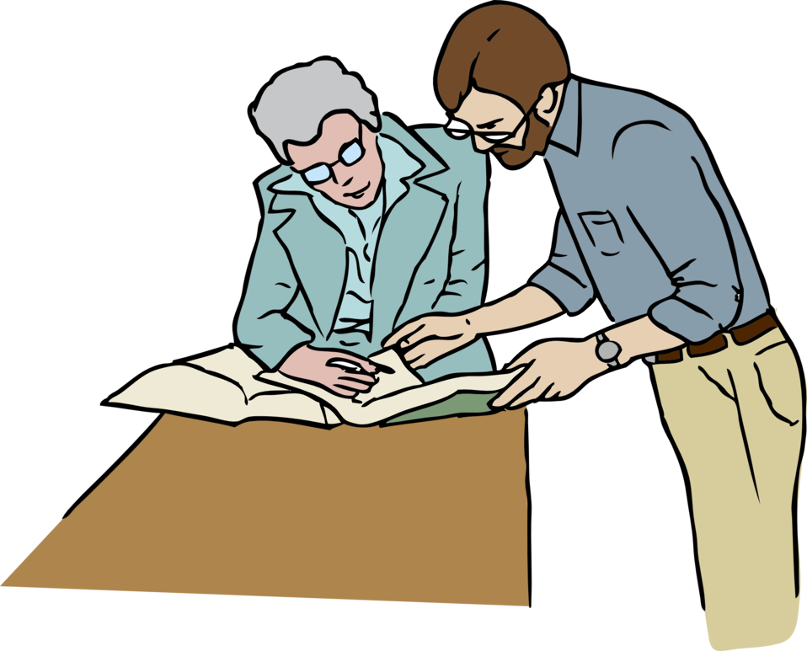

References
https://pypi.org/project/gTTS/
https://pypi.org/project/SpeechRecognition/
https://www.analyticsvidhya.com/blog/2021/07/detecting-face-masks-using-transfer-learning-and-pytorch/
https://pypi.org/project/pydub/
https://pypi.org/project/opencv-python/
https://docs.opencv.org/3.4/d6/d00/tutorial_py_root.html
https://docs.python.org/3/library/smtplib.html
https://community.openhab.org/t/playsound-stops-working/90266/6
https://docs.python.org/3/library/time.html

Slide 18
https://docs.python.org/3/library/os.html
https://docs.python.org/3/library/email.message.html
https://docs.python.org/3/library/datetime.html
https://docs.python.org/3/library/imghdr.html
https://docs.github.com/en/get-started/quickstart/set-up-git
https://www.youtube.com/watch?v=FPRFYYMlhyw&t=2570s

